Slide 1
SAP Content Catalog

Slide 2
Table of Contents
1
WebUI
2
Discover
3
Design
4
Monitor

Slide 3
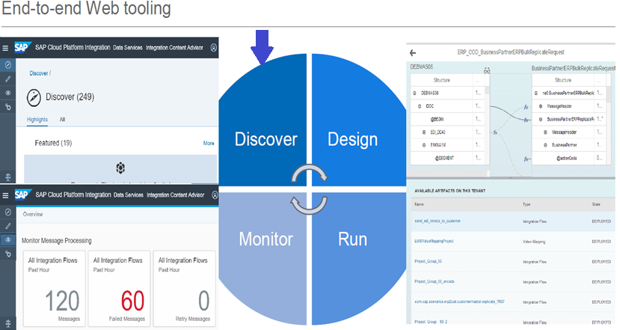
1.WebUI
SAP CPI WebUI tools allows the developers to Copy/Create a integration content, Deploy and monitor it.
Discover
Discover contains Standard Integration Content Catalog.
Design
Design helps to create/edit a content using Modelling area
Operations/Monitor
Operation’s view is used to monitor deployed content and messages processed in the tenant .
Contains Message Processing logs, Connectivity Tests, Security Materials, Logs and Traces

Slide 4
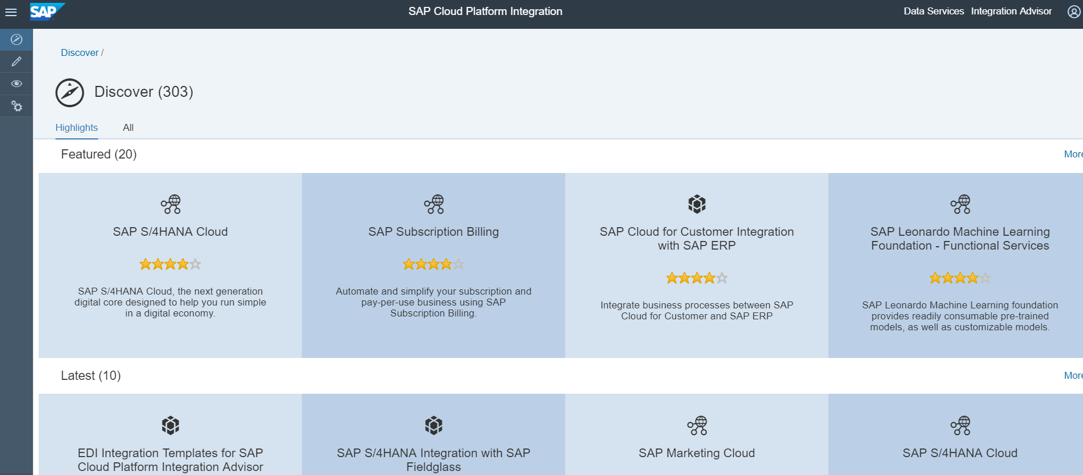
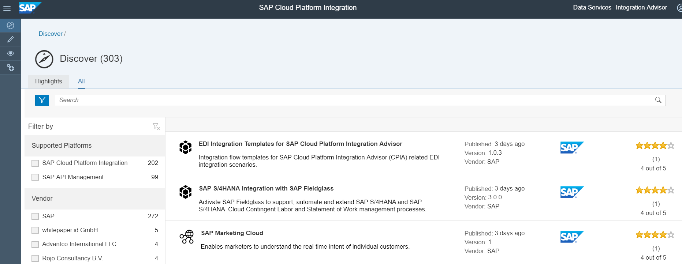
2.Discover
Discover contains Standard Integration Content Catalog for various Business processes.
Packages are tested and published by SAP/ External Vendors.
These packages are well documented and released with Configure only/Editable mode.
Standard packages have to copied to Own workspace and deployed by providing
Streams
Vendor
Supported Platforms
Line of Business
Industries
Products
Countries

Slide 5
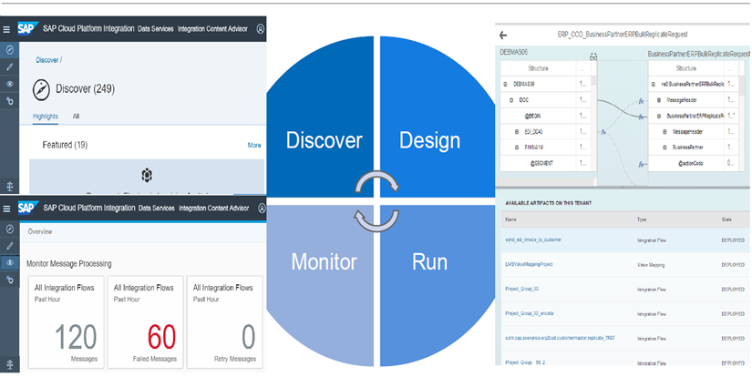
3.Design
Design platform enables the developers to model integration flows configure attributes of the integration flows, and deploy them to the runtime.
These contents are bundled together through Packages under which various artifacts can be created based on the requirement
This allows the developer to create custom components based on the Business process from scratch.
Graphical designer and Palettes functions are used within the Integration flow for designing complex business flow.
Artifacts
Integration Flow
OData Service
Value Mapping
Data Integration

Slide 6
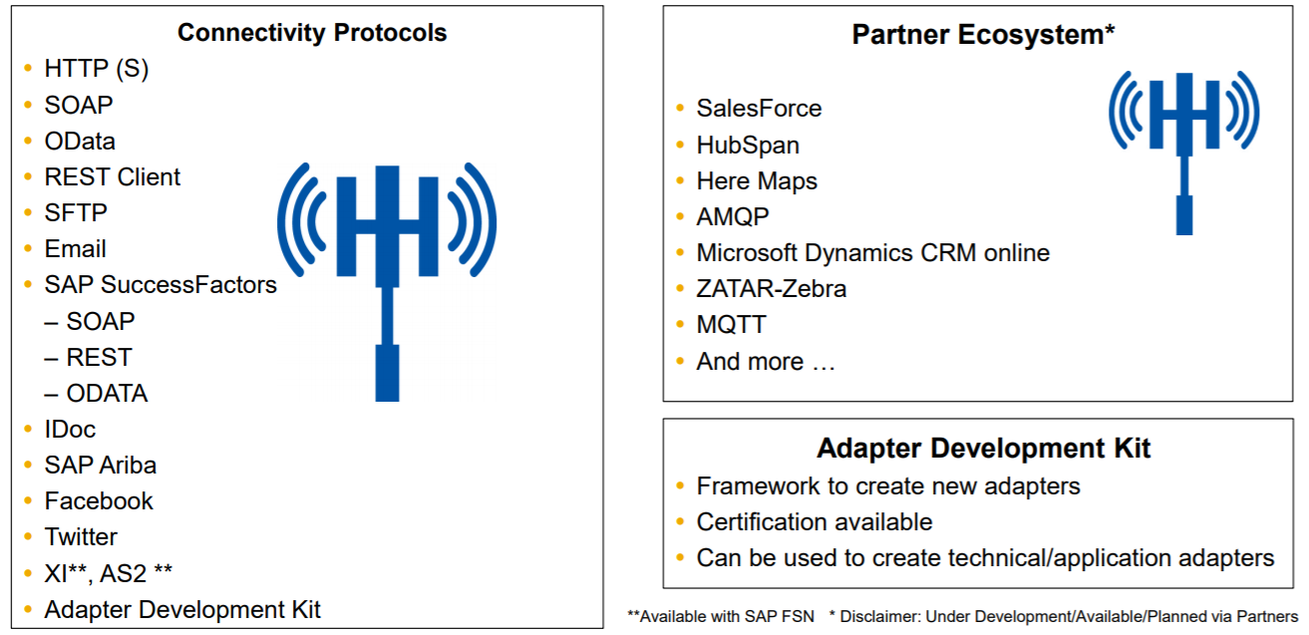
3.Design
Connectivity Protocols
Latest list of adapters can be checked from the below URL:
https://help.sap.com/viewer/368c481cd6954bdfa5d0435479fd4eaf/Cloud/en-US/55325f2a722c4f67bb7752b369b09ff8.html?q=adapters

Slide 7
4.Monitor
An integration developer can use Operation's view to check status of messages and integration content artifacts for a tenant cluster using various sections.
Monitor Message Processing
Monitor message processing on the tenant within time frame
Manage Integration Content
Manage integration content for the tenant
Manage Security
Allows us to manage certain tasks related to the setup of secure connections between tenant and remote systems.
Contains Keystore, Security Material, Connectivity Test and etc.
Manage Stores
Access Logs
Manage Locks

Slide 8


